Slide 1
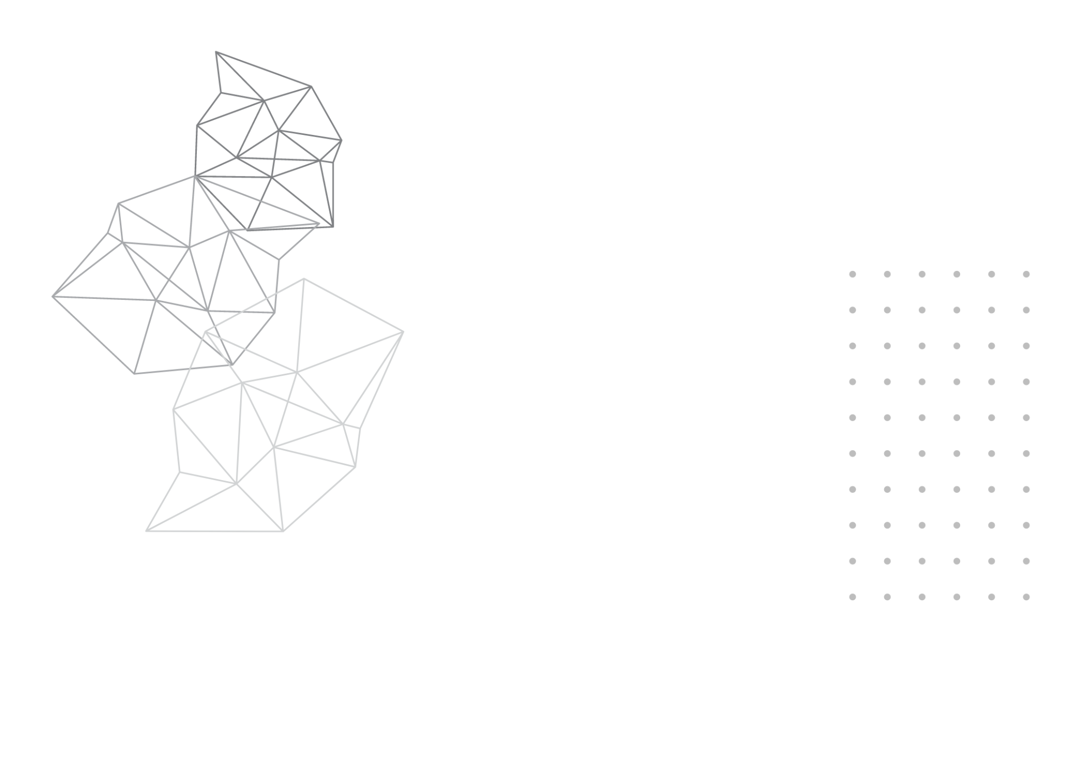

DeMedia
Decentralized Social Media Protocol
TMP-23-234

Slide 2






DeMedia Team
Mr. Kavinga Abeywardena
Ms. Laneesha Ruggahakotuwa
Supervisor
Co-Supervisor
Perera B.S.S.
Bandara A.M.C.A.
Dhananjani G.G.S.
Abeykoon A.W.Y.I.K.
IT20254698
IT20159726
IT20137496
IT20157432

Slide 3




Introduction
What is a social media platform?
According to the Tufts University[1],
“Social media refers to the means of interactions among people in which they create, share, and/or exchange information and ideas in virtual communities and networks.”

Slide 4
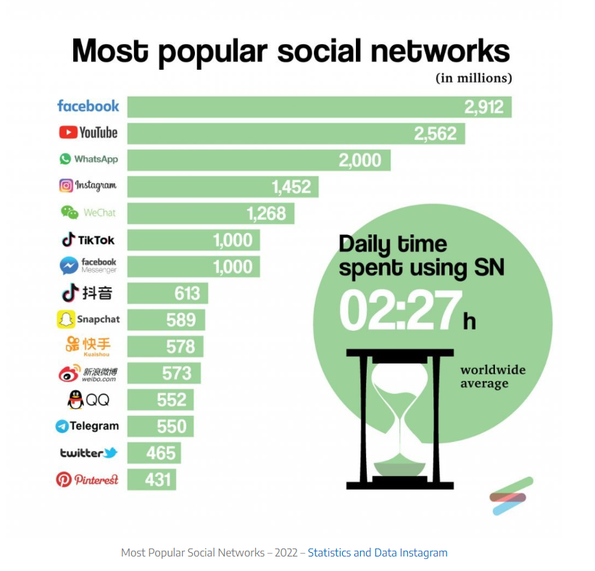
Role Of Social Media At Present

Slide 5
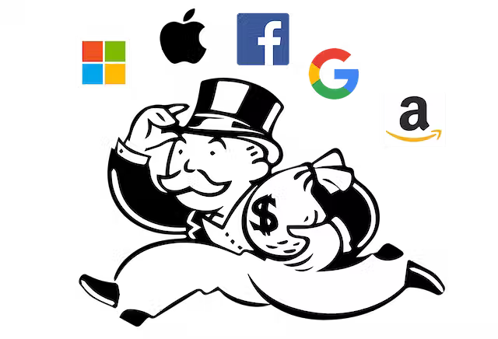

Major Issues In Current Social Media Platforms
The difficult balance between user privacy and platform transparency
The need to trust the social media corporation for the security of confidential data
Lack of regulation for social media companies
Monopoly among leading social media companies
Algorithms contribute to bias, racism, and polarization
Social media business models don’t always serve users

Slide 6
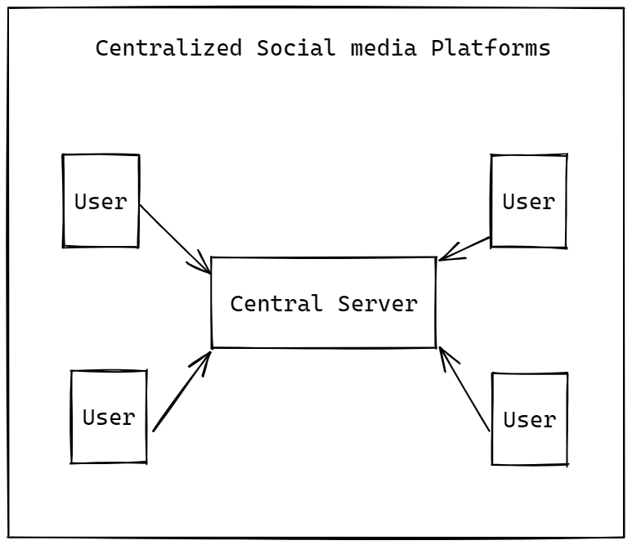
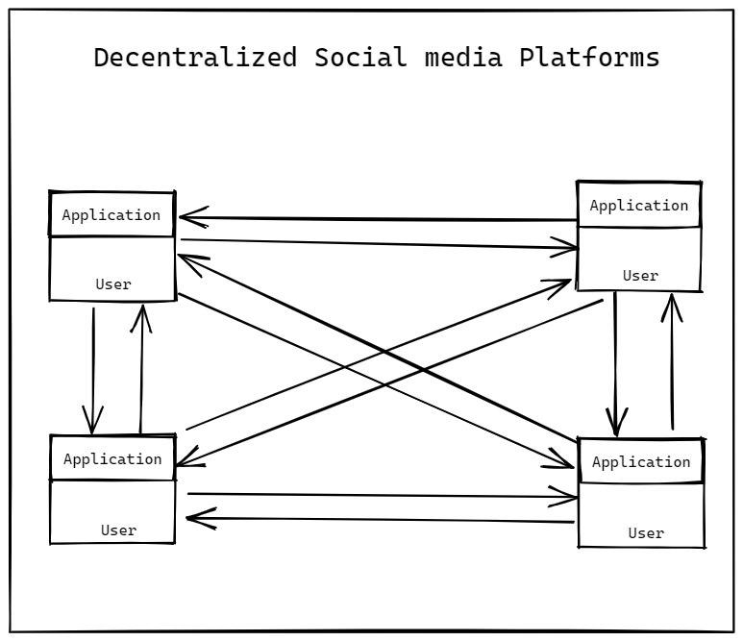
Centralized Applications vs Decentralized Applications
Centralized
Decentralized

Slide 7
Research Problem
Existing social media platforms do not allow users to govern the data they upload or share on their platforms. This has resulted in numerous disagreements among users, and major social media corporations use this user information to gain revenue while compromising the confidentiality of the user data to third parties.
The current social media platforms have given rise to a number of issues that prompt the need for a new approach to decentralized social media.

Slide 8
Research Problem Contd.
In particular, the following issues have come to the fore:
How to implement decentralized protocol to support social media platforms
How to ensure transparency in the flow of application data.
How to grant users true control over their own data.
How to provide a centralized application like user experience on a decentralized application.

Slide 9
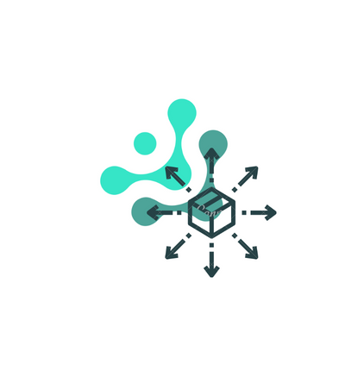


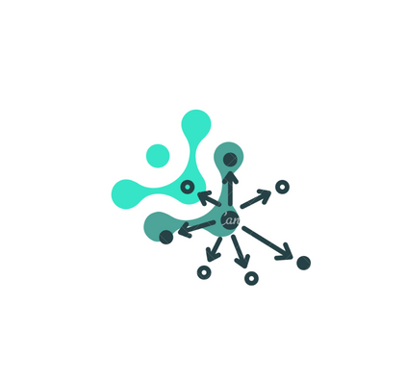
Solution
DeMedia - a protocol that facilitates the development of decentralized social media platforms.

Slide 10
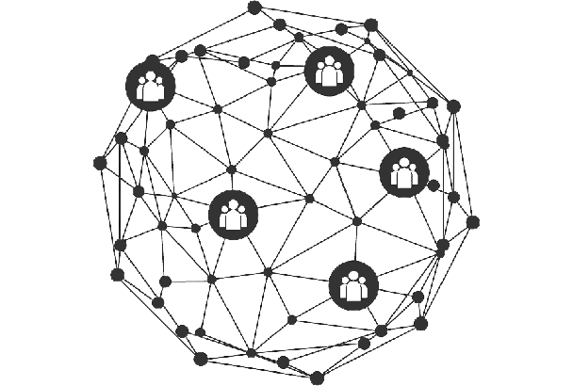
Why Decentralization?
Ownership over confidential data
Less susceptible to data breaches
Improved control over user content
Censorship resistance

Slide 11
Objectives
Implement a protocol that facilitates the development of decentralized social media platforms.
Implement a peer-to-peer
communication protocol
Implement user data
decentralization protocol
Implement a mechanism for
decentralized data integrity
Implement a mechanism for
decentralized
data caching

Slide 12
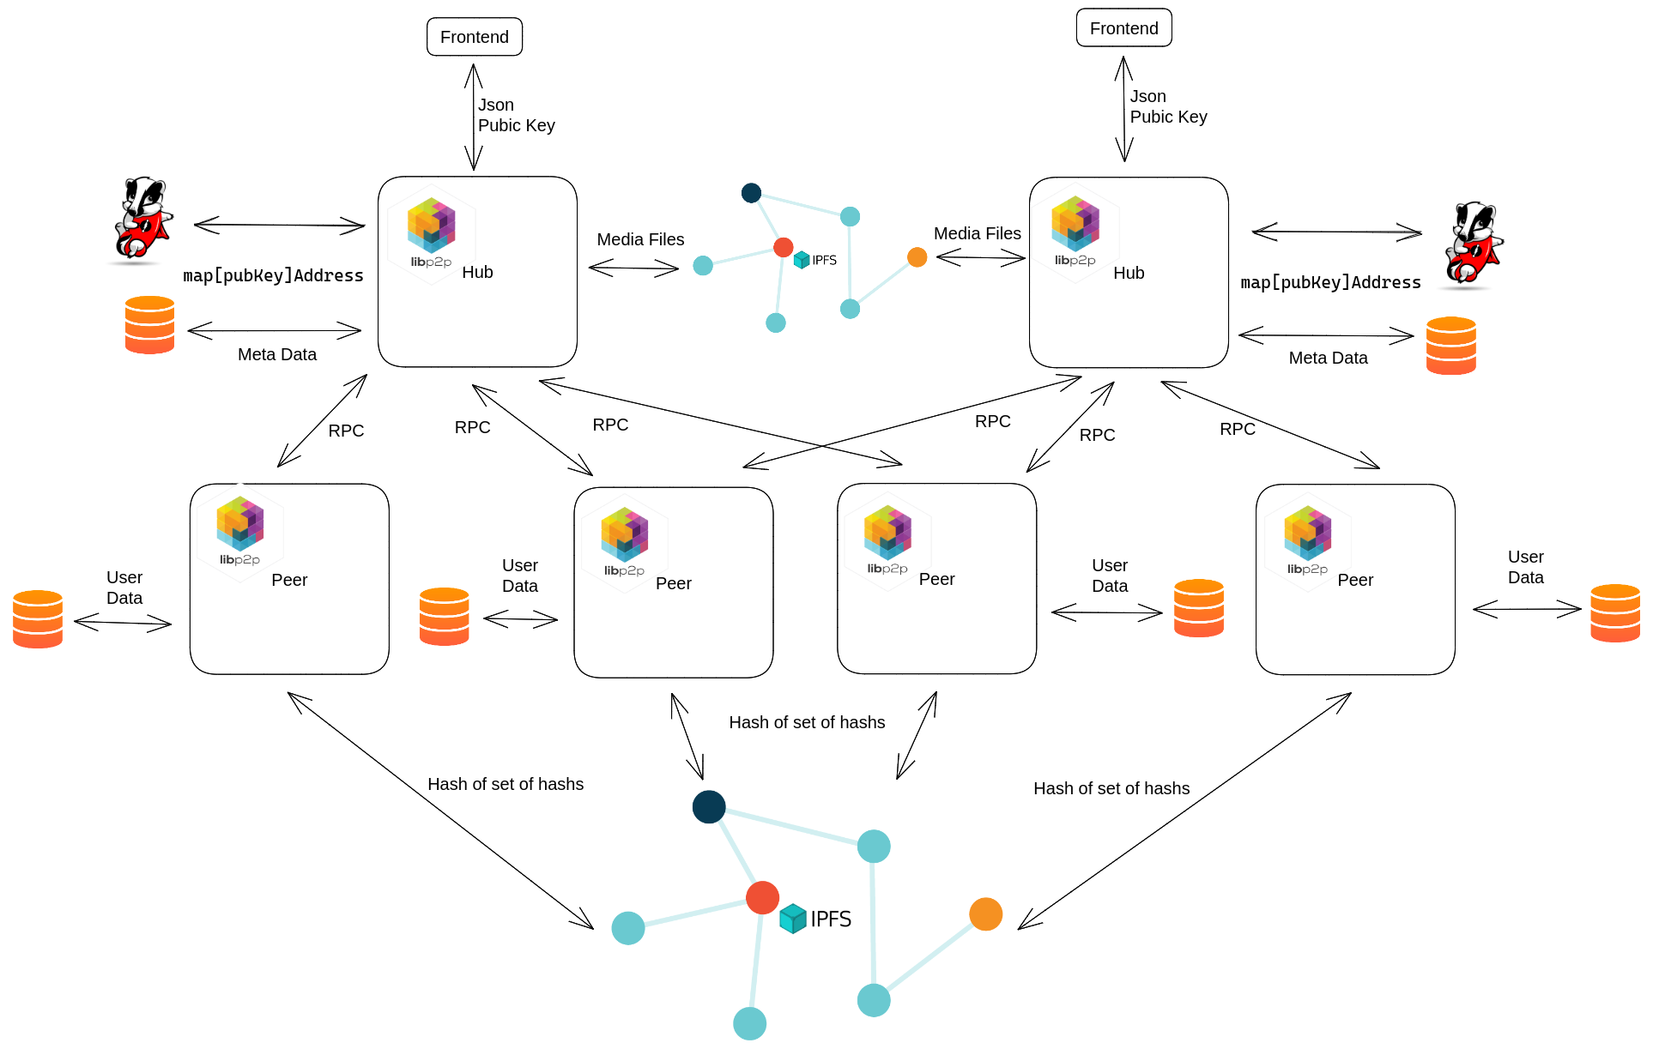
Overall System Architecture

Slide 13
REFERENCES
[1] “Social Media Overview,” Tufts University Relations, 05-Mar-2021. [Online]. Available: https://communications.tufts.edu/marketing-and-branding/social-media-overview/. [Accessed: 24-Mar-2023].
[2] “Most popular social media 2004/2022,” Statistics and Data, 29-Jun-2022. [Online]. Available: https://statisticsanddata.org/data/most-popular-social-media-in-history/. [Accessed: 24-Mar-2023].

Slide 14
PERERA B.S.S | IT20254698 | IT
PEER TO PEER COMMUNICATION
IT20254698 | Perera B.S.S. | TMP 23-234

Slide 15





Introduction
Successful projects in past
Skype [1]
Gnutella [2]
Kazaa [2]
eMule [3]
Torrent [4]
IT20254698 | Perera B.S.S. | TMP 23-234

Slide 16
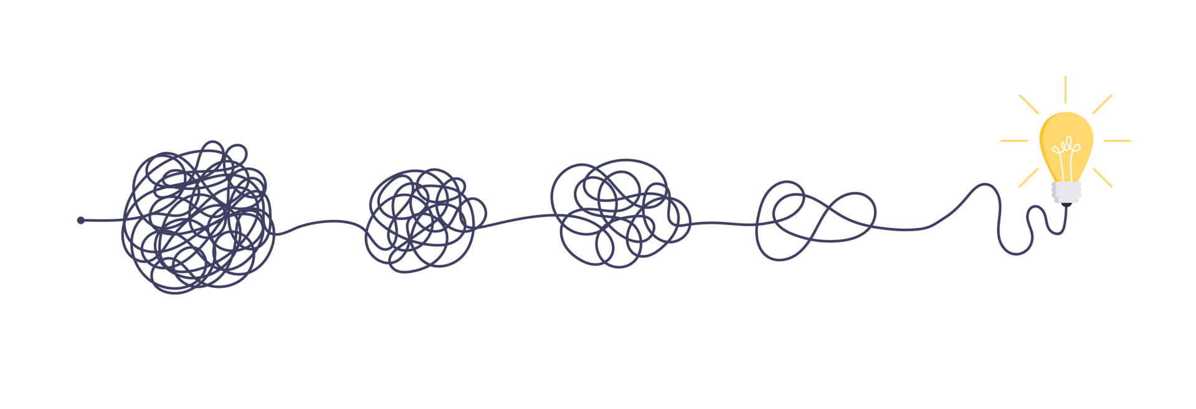
Research Problem
What is the best way to communicate in peer to peer network
How to scale peer to peer communication network
How to implement general purpose peer to peer protocol
IT20254698 | Perera B.S.S. | TMP 23-234

Slide 17
Research Gap
 | Skype | Gnutella | Kazaa | eMule | Torrent | DeMedia
Live | Yes | No | No | No | Yes | Yes
Open source | No | Yes | No | No | Yes | Yes
Documented | No | Yes | No | No | Yes | Yes
Scalable | No | No | No | No | Yes | Yes
General purpose | No | No | No | No | No | Yes
IT20254698 | Perera B.S.S. | TMP 23-234

Slide 18

Sub Objectives
Design RPC style full duplex communication protocol
Use key-value store to keep track of peers
Utilizing third party storage providers for file sharing
Implement protocol with flexibility for any kind peer to peer communication
IT20254698 | Perera B.S.S. | TMP 23-234

Slide 19

Novelty Aspect
RPC style API
Support for both textual and binary content
Asymmetric encryption
Full duplex communication
IT20254698 | Perera B.S.S. | TMP 23-234

Slide 20
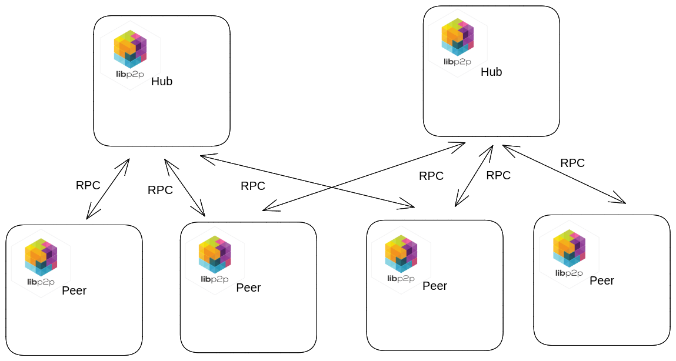
System Architecture
IT20254698 | Perera B.S.S. | TMP 23-234

Slide 21
Functional & Non functional Requirements
Functional Requirements
Discover other peers on the network and establish connections with them
Should be able to transfer binary objects from one peer to another peer
Flexible API for integration with any peer to peer application
Non functional Requirements
Performance
Fault tolerance
Scalability
Availability
Usability
Better developer experience
IT20254698 | Perera B.S.S. | TMP 23-234

Slide 22
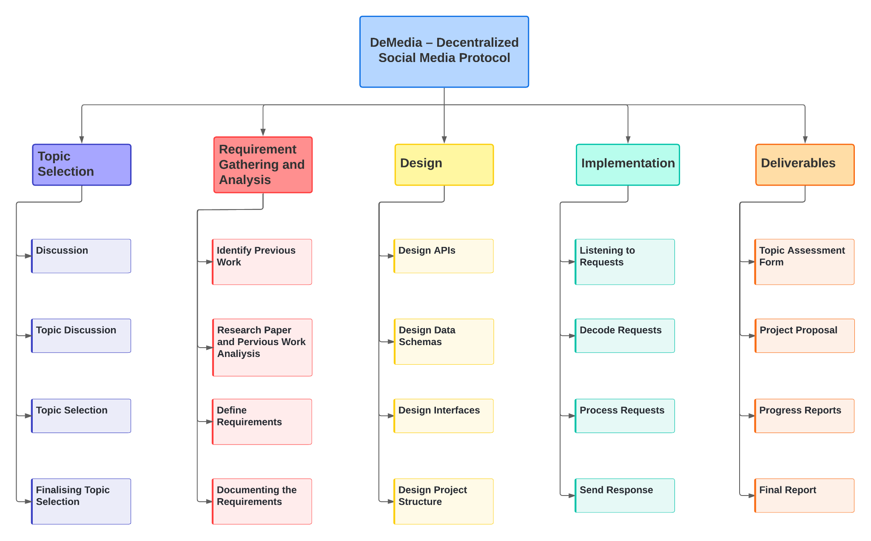
Work Breakdown Structure(WBS)
IT20254698 | Perera B.S.S. | TMP 23-234

Slide 23
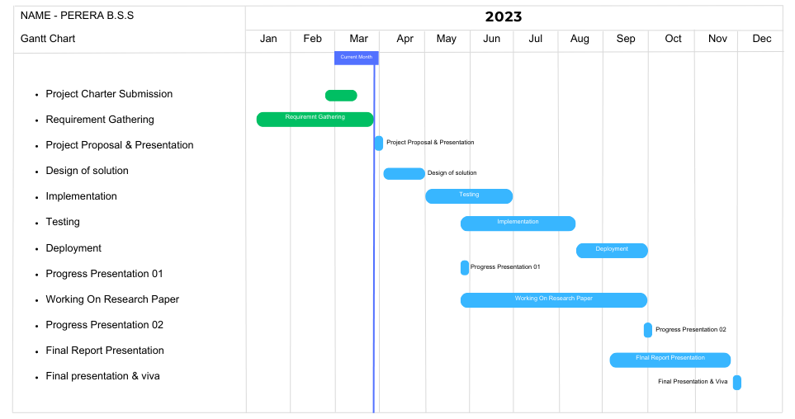
Completion Of The Project
IT20254698 | Perera B.S.S. | TMP 23-234

Slide 24
REFERENCES
[1] Y. A.-N. R. M. N. Mehdi Jahanirad*, "Security measures for VoIP application: A state of the art review" [Academic Journals, 2011].
[2] S. K. M. G. Leonidas Lymberopoulos, "Deliverable D.6.1: ARGUGRID Platform Design" [2007].
[3] D. B. Yoram Kulbak, "The eMule/eDonkey protocol," 2005 17 January. [Online]. Available: http://pages.di.unipi.it/ricci/e-mule-report.pdf. [Accessed: 24-Mar-2023].
[4] B. Cohen, 22 May 2003. [Online]. Available: https://stuker.com/wp-content/uploads/import/i-1fd3ae7c5502dfddfe8b2c7acdefaa5e-bittorrentecon.pdf.[Accessed: 24-Mar-2023].
IT20254698 | Perera B.S.S. | TMP 23-234

Slide 25
Bandara A.M.C.A. | IT20159726 | IT
USER DATA DECENTRALIZATION
PROTOCOL
IT20159726 | Bandara A.M.C.A. | TMP 23-234

Slide 26
Introduction
The primary goal is to grant complete data ownership control to the user.
Presently, numerous decentralized social media platforms exist in the market[1].
A significant proportion of these platforms are blockchain-based[2].
While many researches have been done on decentralizing social media[3],
Most of them are done using blockchain, which is not an optimal solution[4].
IT20159726 | Bandara A.M.C.A. | TMP 23-234

Slide 27
Research Problem
What measures can be taken to provide users with complete ownership of their data?
What potential solutions exist for overcoming the limitations of blockchain when using it to store large quantities of data?
What enhancements can be made to current decentralized social media networks?
IT20159726 | Bandara A.M.C.A. | TMP 23-234

Slide 28
Research Gap
 | Mastodon[5] | DeSo[6] | DeMedia
User Data Storage | In hosted server | In DeSo blockchain | In user’s device
Support decentralized data storage in user device | No | No | Yes
Self-hosting | yes | Partially | Yes
Scalability | No | Partially | Yes
Caching | No | No | Yes
Installable client | Only mobile | No | Yes
IT20159726 | Bandara A.M.C.A. | TMP 23-234

Slide 29
Sub Objectives
Enable user to control user data
Utilizing user device to store user data
Improving limitations in current decentralized social media platforms
Making user data highly available
IT20159726 | Bandara A.M.C.A. | TMP 23-234

Slide 30

Novelty Aspect
Implementation of user data decentralization protocol which supports storation of user data within user device.
IT20159726 | Bandara A.M.C.A. | TMP 23-234

Slide 31
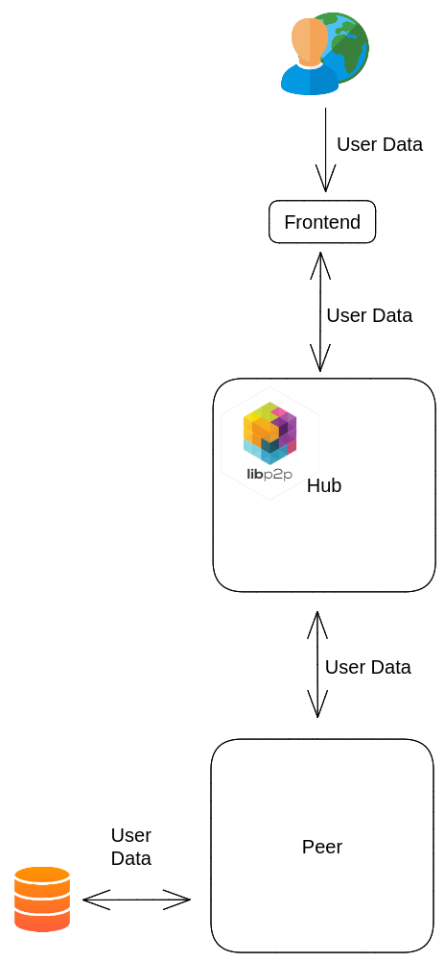
System Architecture
IT20159726 | Bandara A.M.C.A. | TMP 23-234

Slide 32
Functional & Non functional Requirements
Functional Requirements
Connection Establishment with hubs
In-device storage integration
Representation of connection status with connected hubs
Content sharing to network
Non functional Requirements
Performance
Fault tolerance
Scalability
Availability
Usability
Better developer experience
IT20159726 | Bandara A.M.C.A. | TMP 23-234

Slide 33
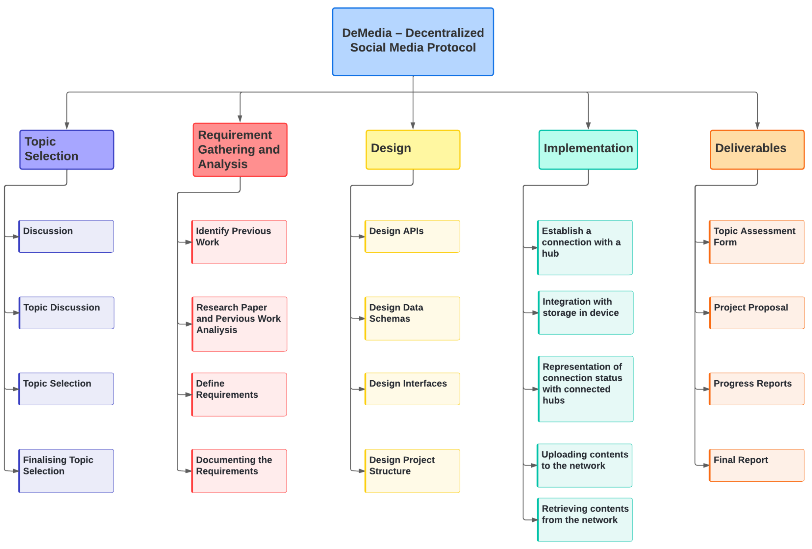
Work Breakdown Structure(WBS)
IT20159726 | Bandara A.M.C.A. | TMP 23-234

Slide 34

Completion Of The Project
IT20159726 | Bandara A.M.C.A. | TMP 23-234

Slide 35
REFERENCES
[1]. C. Staff, “Blockchain social media and crypto social media,” Cryptopedia . [Online]. Available: https://www.gemini.com/cryptopedia/blockchain-social-media-decentralized-social-media#section-blockchain-and-social-media. [Accessed: 20-Mar-2023].
[2]. Sketchar, “What advantages does web 3.0 give to creators?,” Sketchar, 03-Mar-2023. [Online]. Available: https://blog.sketchar.io/what-advantages-does-web-3-0-give-to-creators/. [Accessed: 20-Mar-2023].
[3]. T. Cai, Z. Hong, S. Liu, W. Chen, Z. Zheng and Y. Yu, "SocialChain: Decoupling Social Data and Applications to Return Your Data Ownership," in IEEE Transactions on Services Computing, vol. 16, no. 1, pp. 600-614, 1 Jan.-Feb. 2023, doi: 10.1109/TSC.2021.3128959.
[4]. R. Nourmohammadi and K. Zhang, "An On-Chain Governance Model Based on Particle Swarm Optimization for Reducing Blockchain Forks," in IEEE Access, vol. 10, pp. 118965-118980, 2022, doi: 10.1109/ACCESS.2022.3221419.
[5]. “Decentralized social media,” Mastodon. [Online]. Available: https://joinmastodon.org/. [Accessed: 20-Mar-2023].
[6]. S. Freight, “The decentralized social blockchain,” DeSo. [Online]. Available: https://www.deso.com/. [Accessed: 20-Mar-2023].
IT20159726 | Bandara A.M.C.A. | TMP 23-234

Slide 36
Dhananjani G.G.S. | IT20137496 | IT
DECENTRALIZED DATA INTEGRITY
IT20137496 | Dhananjani G.G.S. | TMP 23-234

Slide 37
Introduction
Data integrity is a main aspect of any application. [1]
Currently, there are various mechanisms available to maintain the integrity of data in decentralised application.
In here, try to implement a proper data integrity mechanism on top of IPFS.
IT20137496 | Dhananjani G.G.S. | TMP 23-234

Slide 38

Research Problem
How to maintain integrity of user data which saved on user device?
What is the best mechanism for achieve user data integrity?
How to ensure user data integrity using IPFS network? [2]
IT20137496 | Dhananjani G.G.S. | TMP 23-234

Slide 39
Research Gap
 | Mastodon | DeSo | DeMedia
Generate hash for user data | Yes | Yes | Yes
Sign user data | Yes | Yes | Yes
Keep data Integrity in User’s device | No | No | Yes
Use IPFS for keep Integrity | No | No | Yes
Integrity in Data sharding | Yes | No | Yes
IT20137496 | Dhananjani G.G.S. | TMP 23-234

Slide 40
Sub Objectives
Ensure consistency in preparation for hashing and signing
Ensures the data security distributed across multiple nodes
Verify the authenticity of the data
Ensure that the data has not been altered or tampered with during storage
IT20137496 | Dhananjani G.G.S. | TMP 23-234

Slide 41


Novelty Aspect
Maintain integrity of user data in user’s device.
Store set of signed hashes of user data in IPFS to maintain user data integrity.
IT20137496 | Dhananjani G.G.S. | TMP 23-234

Slide 42
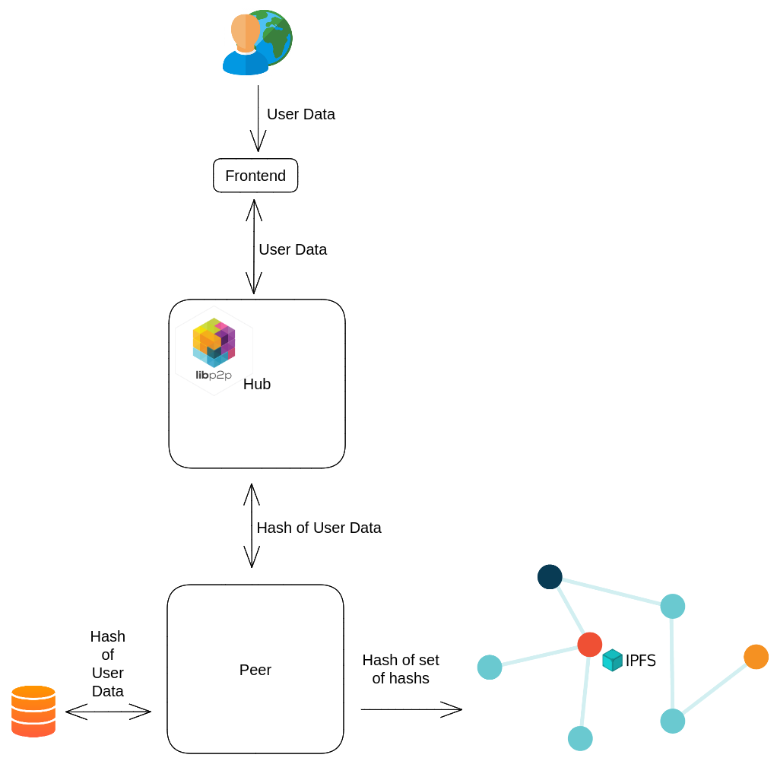
System Architecture
IT20137496 | Dhananjani G.G.S. | TMP 23-234

Slide 43
Functional & Non functional Requirements
Functional Requirements
Hashing algorithm
Digital signatures
Maintain data integrity of saved
user data in user device
Hash the set of hash values
Maintain data integrity in IPFS
Maintain data integrity sharding
Non functional Requirements
Integrity
Security
Privacy
Availability
Usability
Reliability
IT20137496 | Dhananjani G.G.S. | TMP 23-234

Slide 44
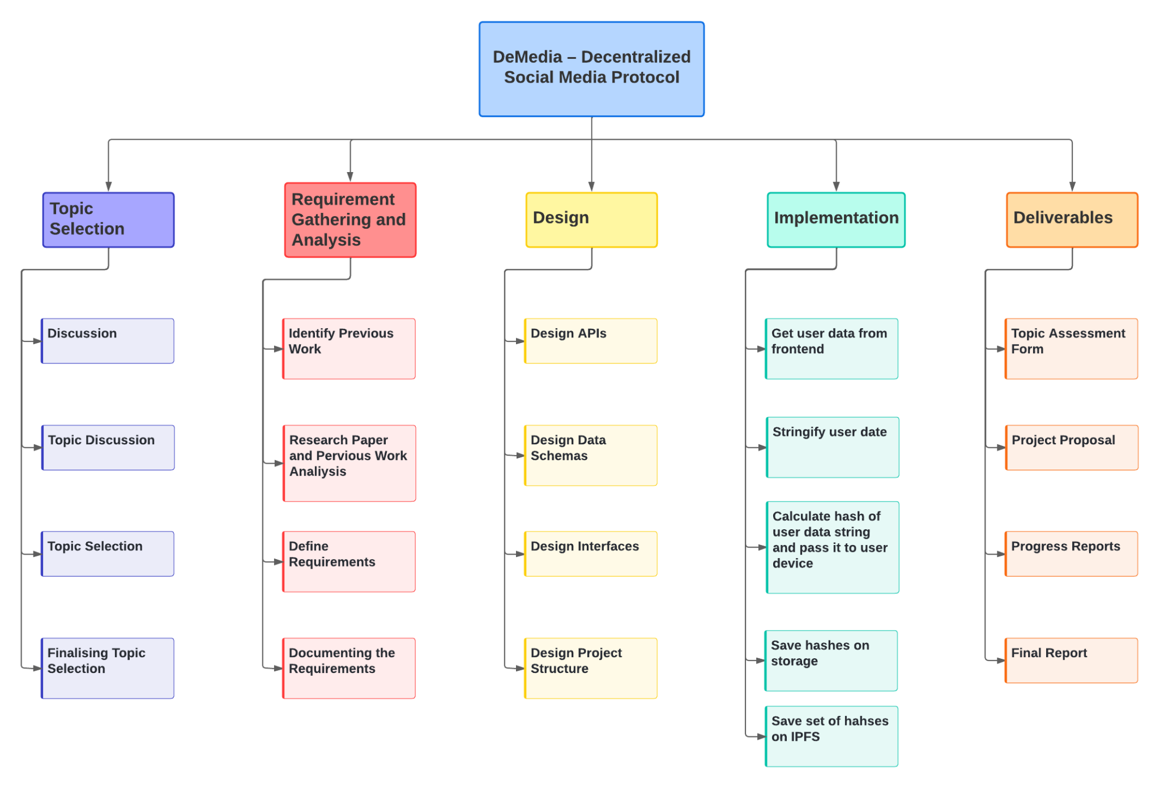
Work Breakdown Structure(WBS)
IT20137496 | Dhananjani G.G.S. | TMP 23-234

Slide 45

Completion Of The Project
IT20137496 | Dhananjani G.G.S. | TMP 23-234

Slide 46
REFERENCES
[1] Vishwanath G. Garagad, Nalini C. Iyer, Heera G. Wali, "Data Integrity: A security threat for Internet of Things and Cyber-Physical Systems", IEEE 2020.
[2] Kelsie Nabben ,"Decentralized Technology in Practice: Social and technical resilience in IPFS", IEEE, 2022.
[3] “Decentralized social media,” Mastodon. [Online]. Available: https://joinmastodon.org/. [Accessed: 20-Mar-2023].
[4] S. Freight, “The decentralized social blockchain,” DeSo. [Online]. Available: https://www.deso.com/. [Accessed: 20-Mar-2023].
[5] “What is the Mastodon social media platform?,” Internet Matters, 15-Mar-2023. [Online]. Available: https://www.internetmatters.org/hub/news-blogs/what-is-mastodon-social-media/. [Accessed: 20-Mar-2023].
[6] "IPFS Docs," [Online]. Available: https://docs.ipfs.tech/.
[7] Quanqing Xu, “Building an Ethereum and IPFS-Based Decentralized Social Network System”, IEEE, 2018.
[8] Ma Haifeng, Zhang Ji, "Block-chain based cloud storage integrity verifycation scheme for recoverable data", IEEE 2022.
[9] Biwen Chen, "A Blockchain-Based Searchable Public-Key Encryption With Forward and Backward Privacy for Cloud-Assisted Vehicular Social Networks", IEEE 2022.
[10] Subhashish Mazumdar, "From data integrity to inference integrity", IEEE 2017.
[11] Bogdan Tiganoaia, "The use of social platforms and personal data protection — An exploratory study" IEEE, 2017.
IT20137496 | Dhananjani G.G.S. | TMP 23-234

Slide 47
ABEYKOON A.W.Y.I.K. | IT20157432 | IT
DECENTRALIZED DATA CACHING
IT20157432 | Abeykoon A.W.Y.I.K. | TMP 23-234

Slide 48
Introduction
“Caching your way to a decentralized social media experience that's fast and efficient”
Decentralized social media protocols that preserve data caching are essential for improving network performance It increases in storage optimization and reduces the amount of traffic on the decentralized storage network. It help to lower the cost of network operations and improve scalability, dependability, and cost effectiveness.
Ex :Diaspora, Scuttlebutt, Peepath, Steemit, Minds, Akasha
There are many kind of decentralized storage networks
Ex : Storj, Filecon, Arware , BitTorrent, IPFs (InterPlanetary File System)
IT20157432 | Abeykoon A.W.Y.I.K. | TMP 23-234

Slide 49

Research Problem
What is the most effective caching strategy for issues of caching mechanism?
What we can do for minimize resource usage?
Why we use IPFS to implement the caching mechanism?
IT20157432 | Abeykoon A.W.Y.I.K. | TMP 23-234

Slide 50
Research Gap
 | Mastodon | Steemit | Peepath | DeMedia
Caching | No | Yes | Yes | Yes
Decentralized Data Storage Network | No | IPFS | Swarm | IPFS
Blockchain based | No | Yes | Yes | No
Scalability | No | Yes | Yes | Yes
Resource Consumption | low | high | Medium | low
Integration with existing systems | No | No | No | Yes
IT20157432 | Abeykoon A.W.Y.I.K. | TMP 23-234

Slide 51
Sub Objectives
Integrating the caching mechanism with the IPFS
Reduce resource consumption in data storage
Improve Scalability, Efficiency, and Flexibility, Lower transaction fees
To evaluate the ease of integration and development efficiency
IT20157432 | Abeykoon A.W.Y.I.K. | TMP 23-234

Slide 52

Novelty Aspect
Implement the caching mechanism for decentralized social media platform using IPFS which will support the user data storation within the user device.
IT20157432 | Abeykoon A.W.Y.I.K. | TMP 23-234

Slide 53
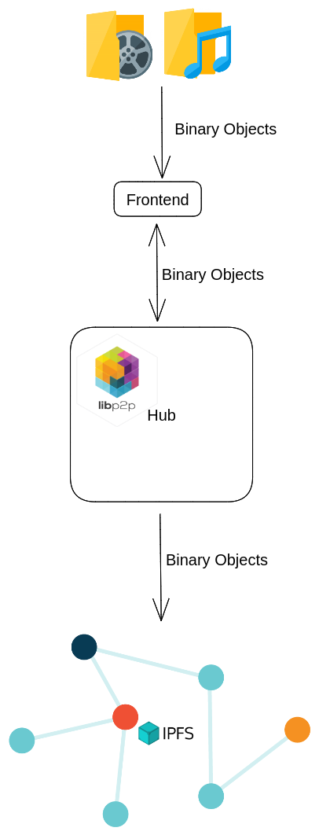
System Architecture
IT20157432 | Abeykoon A.W.Y.I.K. | TMP 23-234

Slide 54
Functional & Non functional Requirements
Functional Requirements
Upload multimedia files from frontend
Optimize multimedia files
Push multimedia files to IPFS
Save addresses of multimedia files in storage
Non functional Requirements
Performance
Fault tolerance
Scalability
Availability
Usability
Better developer experience
IT20157432 | Abeykoon A.W.Y.I.K. | TMP 23-234

Slide 55
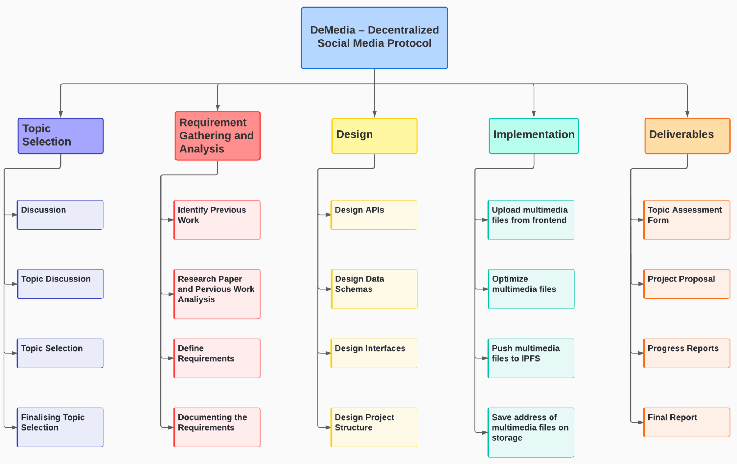
Work Breakdown Structure(WBS)
IT20157432 | Abeykoon A.W.Y.I.K. | TMP 23-234

Slide 56

Completion Of The Project
IT20157432 | Abeykoon A.W.Y.I.K. | TMP 23-234

Slide 57
REFERENCES
[1] R. Schollmeier, "A definition of peer-to-peer networking for the classification of peer-to-peer architectures and applications," IEEE, 2001.
[2] F. A. Alabdulwahhab, "Web 3.0: The Decentralized Web Blockchain networks and Protocol Innovation," IEEE, 2019.
[4] B. Zhang and H. Wu, "A new distributed caching replacement strategy," IEEE, 2011.
[5] B. P. Robert Sheldon, "7 decentralized data storage networks compared," TechTarget, 05 June 2022. [Online]. Available: https://www.techtarget.com/searchstorage/tip/Comparing-4-decentralized-data-storage-offerings.
[6] F. T. Erik Daniel, "IPFS and Friends: A Qualitative Comparison of Next Generation Peer-to-Peer Data Networks," IEEE, 2022.
[7] M. K. G. Newton Masinde, "Caching Structures for Distributed Data Management in P2P-based Social Networks," IEEE, Montreal, QC, Canada, 2020.
[8] D. J. Tharuka Sarathchandra, "A decentralized social network architecture," IEEE, 2021.
[9] M. P. B. N. S. M. a. L. I. L. Han, "SocialCDN: Caching techniques for distributed social networks," IEEE 12th International Conference, Tarragona, Spain, 2012.
[10] N. K. M. a. G. K. Masinde, "Caching structures for distributed data management in P2P-based social networks," IEEE, Montreal, QC, Canada, 2020.
[11] "IPFS Docs," [Online]. Available: https://docs.ipfs.tech/.
IT20157432 | Abeykoon A.W.Y.I.K. | TMP 23-234

Slide 58
Commercialization Plan
DeMedia is slated to function as an open source protocol, facilitating the creation of decentralized social media platforms that are self-hosted.
DeMedia will provide
A base model which can be utilized for free of charge.
Additionally 2 paid models will also available:
A membership model based on subscription, which can be governed by the host
An advertising-based revenue model that can also be governed by the host

Slide 59
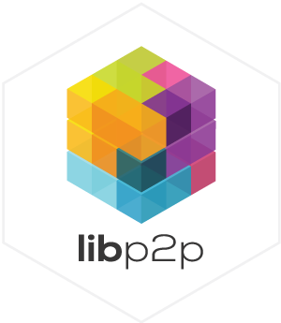









Tools & Technologies
Frontend development
Backend development
Libraries
Data Storage
IDEs and Code Editors

Slide 60





Tools & Technologies
Version Control System
CI/CD
Hosting
Project Management
Communication

Slide 61

Q & A

Slide 62
Thank You!
TMP 23-234

